Slide 1
System Analysis and Design CT026-3-1
Planning (Part 1 of 2)

Slide 2
Topic & Structure of The Lesson
Define problem statement
Describe the purpose of System Change Request
Explain the importance of preliminary investigation

Slide 3
Learning Outcomes
By the end of this module, YOU should be:
Write a Problem Statement
Know about System Change Request
Preliminary Investigation

Slide 4
Key terms you must be able to use
If you have mastered this topic, you should be able to use the following terms correctly in your assignments and exams:
Problem Statement
System Change Request
Preliminary Investigation

Slide 5
Problem Statement
The analyst first defines the problems and objectives of the system. These form the foundation of determining what needs to be accomplished by the system.
A problem definition usually contains some sort of problem statement, summarized in a paragraph or two.
This is followed by a series of issues, or major, independent pieces of the problem. Issues are the current situation
The issues are followed by a series of objectives, or goals that match the issues point by point. Objectives are the desired situation. The objectives may be very specific or worded using a general statement.

Slide 6
System Change Request
The starting point for modifying an information systems
A formal way of asking for assistance from the information systems department.
might propose
enhancements for an existing system,
the correction of problems
the development of an entire new information

Slide 7
System Change Request
Systems Request Forms
Streamlines the request process
Ensures consistency
Easy to understand
Includes clear instructions
Indicates what supporting documents are needed
Most companies use online system request forms that users submitted electronically

Slide 8
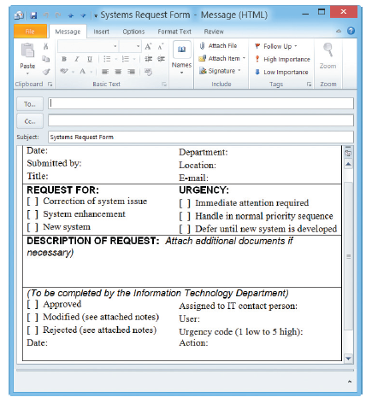
System Change Requests
FIGURE 2-13 Example of an online systems request form.

Slide 9
System Change Requests
Systems Review Committee
Most large companies use a systems review committee to evaluate systems request
With a broader viewpoint, a committee can establish priorities more effectively than an individual
One person’s bias is less likely to affect the decisions
Disadvantages:
Action on requests must wait until the committee meets
Members might favor projects requested by their own departments
Internal political differences could delay important decisions

Slide 10
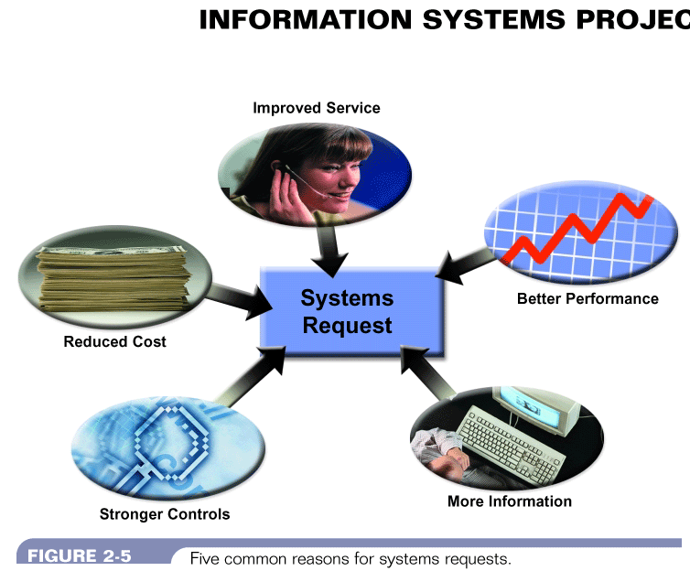
Five common reasons for system change request
Figure 5-3: Five common reasons for systems request
Systems Analysis & Design (4th Edition) – Shelly Cashman Series

Slide 11
Reasons for system change request
to improve service to customers
Can check balance
Can register online
better performance
slow to respond to data inquiries
unable to support company growth
system becomes obsolete when new h/w is
introduced

Slide 12
Reasons for system change request
more information for making decisions
May not be able to analyze market trends
stronger controls
Passwords / encryption
reduced costs
Expensive to operate & maintain old sys
New system more cost effective & better support for long term objectives

Slide 13
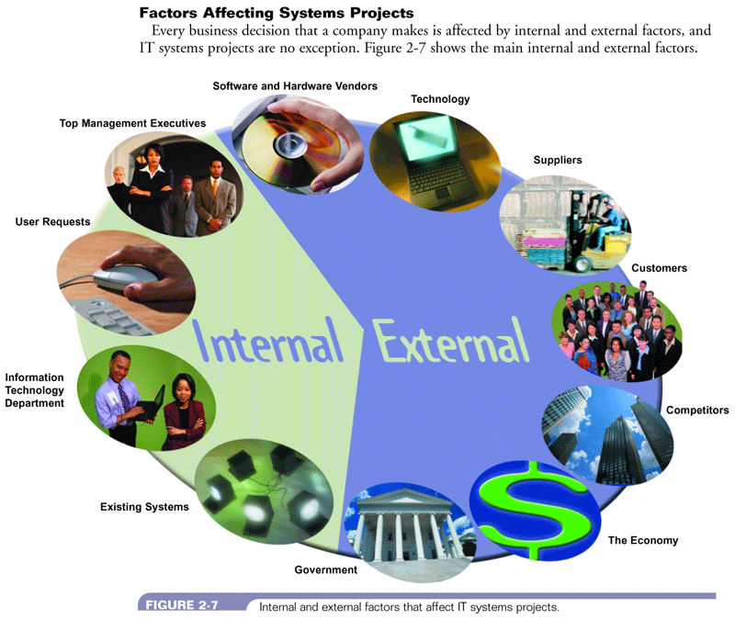
Factors affecting system change request
Figure 5-4: Internal and external factors that affect IT systems projects
Systems Analysis & Design (4th Edition) – Shelly Cashman Series

Slide 14
Resistance to change
Reasons
The threat to job security
The reduction in social satisfaction
The reduction of self-esteem and reputation

Slide 15
Resistance to change
Effects
withholding facts
providing inaccurate data
displaying an attitude of indifference

Slide 16
Resistance to change
Methods to overcome
Keep people informed about
effects of the change on their job
reason for (and the benefits of) the changes
Transfer employee to other department so
that the employee is employed
Extend necessary retraining
Seek Employee Participation

Slide 17
Preliminary Investigation Overview
A systems analyst conducts a preliminary investigation to study the systems request and recommend specific action
The analyst gather facts about the problem or opportunity, project scope and constraints, project benefits and estimated development time and cost
The end product of the preliminary investigation is a report to the management

Slide 18
Preliminary Investigation Overview
Interaction with Managers and Users
Meet with key managers, users, and IT staff to describe the project, explain responsibilities, answer questions, and invite comments
Focus on improvements and enhancements, not problems

Slide 19
Preliminary Investigation Overview
One or more systems analyst investigate a systems request to determine the true nature and scope of the problem and recommend whether it is worthwhile to continue the project
purpose :
gather enough information to determine if the information or problems specified in the systems request warrant
conducting subsequent phases of the SDLC

Slide 20
Quick Review Question
What should we do firs in planning?
Why we need system change request?
Which factors affect system change request?

Slide 21
Summary of Main Teaching Points
The analyst first defines the problems and objectives of the system
System Change Request is the starting point for modifying an information systems
A systems analyst conducts a preliminary investigation to study the systems request and recommend specific action

Slide 22
Question and Answer Session
Q & A

Slide 23
What we will cover next
Planning (Part 2 of 2)
Defining Project Scope and Objectives
Project Scheduling

Slide 24
References
Essential Reading
• Satzinger,J.W., Jackson,R.B., Burd,S.D. (2016). Systems Analysis and Design in a Changing World. 7th ed. Cengage Learning. ISBN: 1305117204 • Valacich,J.A., George,J. (2016). Modern Systems Analysis and Design. 8th ed. Pearson. ISBN: 0134204921
Suggested Reading
• Schwalbe,K. (2016). Information technology project management. 8th ed. Course Technology. ISBN: 9781285452340
K.E. Kendall, J.E. Kendall (2014), Systems Analysis and Design 9th Edition, Pearson; ISBN: 0133023443

